Slide 1
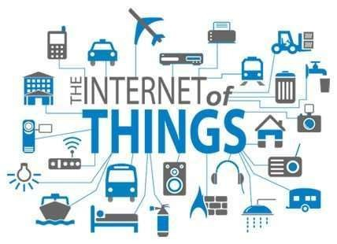

INTERNET OF THINGS(IOT) ARCHITECTURE
Dr.Md. Sazzadur Rahman
Assocaite Professor
IIT-JU
1

Slide 2

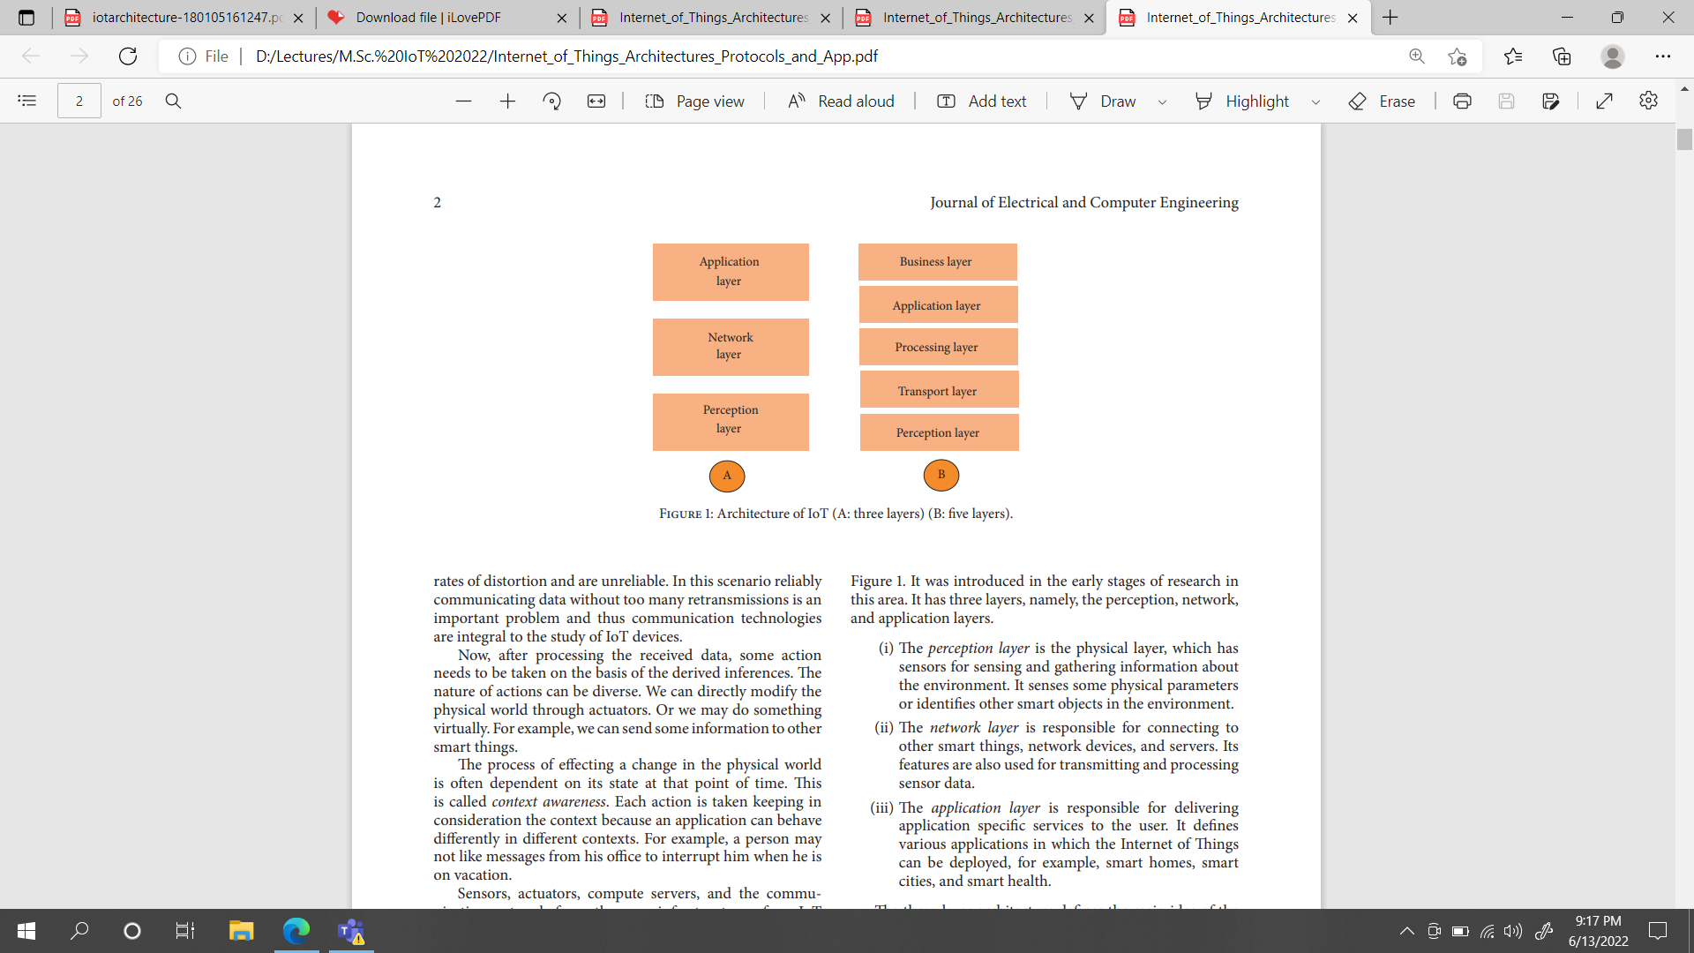
Introduction
There is no single consensus on architecture for IoT, which is agreed universally. Different architectures have been proposed by different researchers.

Slide 3
Three Layered Architecture
The perception layer is the physical layer, which has sensors for sensing and gathering information about the environment. It senses some physical parameters or identifies other smart objects in the environment.
(ii) The network layer is responsible for connecting to other smart things, network devices, and servers. Its features are also used for transmitting and processing sensor data.
(iii) The application layer is responsible for delivering application specific services to the user. It defines various applications in which the Internet of Things can be deployed, for example, smart homes, smart cities, and smart health.

Slide 4
Five Layered Architecture
The five layer architecture, which additionally includes the processing and business layers [3–6]. The five layers are perception, transport, processing, application, and business layers (see Figure ).
The role of the perception and application layers is the same as the architecture with three layers. We outline the function of the remaining three layers.

Slide 5
Five Layered Architecture
(i) The transport layer transfers the sensor data from the perception layer to the processing layer and vice versa through networks such as wireless, 3G, LAN, Bluetooth, RFID, and NFC.
(ii) The processing layer is also known as the middleware layer. It stores, analyzes, and processes huge amounts of data that comes from the transport layer. It can manage and provide a diverse set of services to the lower layers. It employs many technologies such as databases, cloud computing, and big data processing modules
(iii) The business layer manages the whole IoT system, including applications, business and profit models, and users’ privacy.

Slide 6
Cloud and Fog Based Architecture
So far we discussed the protocol based on protocol.
The cloud and fog architectures are system architecture.
In some system architectures the data processing is done in a large centralized fashion by cloud computers. Such a cloud centric architecture keeps the cloud at the center, applications above it, and the network of smart things below it .
Cloud computing is given primacy because it provides great flexibility and scalability. It offers services such as the core infrastructure, platform, software, and storage. Developers can provide their storage tools, software tools, data mining, and machine learning tools, and visualization tools through the cloud.

Slide 7
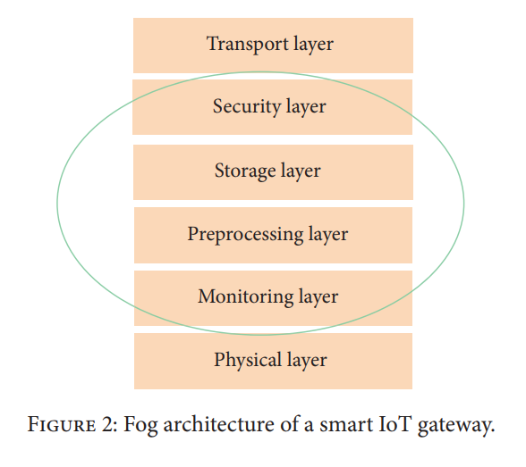
Fog Based Architecture
The sensors and network gateways do a part of the data processing and analytics in fog computing.
A fog architecture presents a layered approach as shown in Figure 2, which inserts monitoring, preprocessing, storage, and security layers between the physical and transport layers.

Slide 8
Fog Based Architecture ……..
The monitoring layer monitors power, resources, responses, and services.
The preprocessing layer performs filtering, processing, and analytics of sensor data.
The temporary storage layer provides storage functionalities such as data replication, distribution, and storage.
Finally, the security layer performs encryption/decryption and ensures data integrity and privacy.
Monitoring and preprocessing are done on the edge of the network before sending data to the cloud.

Slide 9
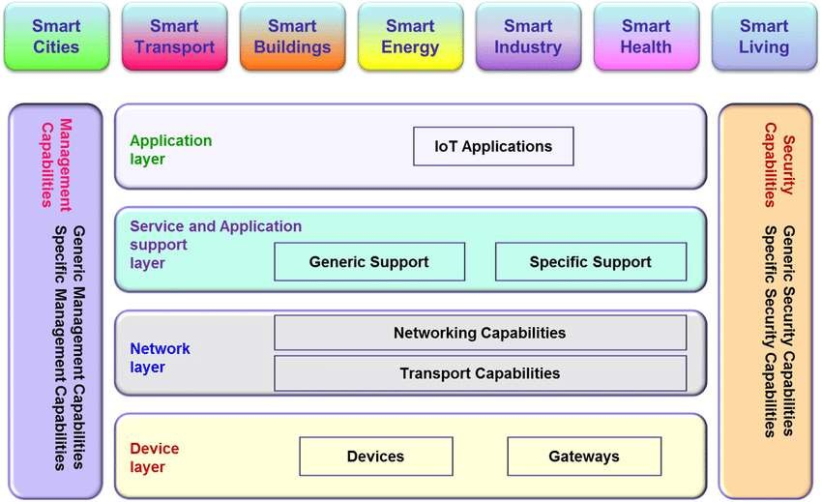
LAYERED ARCHITECTURE OF IOT
6

Slide 10
DEVICE LAYER
Provides a user interface for using IoT.
Different applications for various sectors like Transportation,
Healthcare, Agriculture, Supply chains, Government, Retail etc.
Devices and sensors used are:
GPS
Gyroscope
Accelerometer
Wifi
Ethernet
Bluetooth
7

Slide 11
NETWORK LAYER
Robust and High performance network infrastructure
Supports the communication requirements for latency, bandwidth or security
Allows multiple organizations to share and use the same network independently
Encryption,signal processing,LTE,Wifi,Sim Module,GSM,Micro
controller,Embedded-os etc…are used in network layer.

Slide 12
SERVICE LAYER
Also termed as Application service Layer.
Capturing of periodic sensory data .
Data Analytics (Extracts relevant information from massive amount of raw data).
Streaming Analytics (Process real time data).
Ensures security and privacy of data.

Slide 13
APPLICATION LAYER
Lowest Abstraction Layer.
With sensors we are creating digital nervous system.
Incorporated to measure physical quantities.
Interconnects the physical and digital world.
Collects and process the real time information.
Transportation,Health care,Tracing people,Climatic conditions.etc comes under application layer.

Slide 14
Thank you

